Slide 1
Map Matching of GPS Probe Data
Yanbo Deng
Ruhui Shen
Rui zou

Slide 2
Content
Introduction
Our Method
Result

Slide 3
Introduction

Slide 4
Map Matching of GPS Probe Data
GPS Probe Data
Map Matching
GPS probe data is a Non-Intrusive collection from vehicles and consumer smartphones
Other techniques include cellular data and location-based services data
Given a set of GPS probe data, try to find the matching streets in a given road network.
Also we can identify some feature of the matched road, such as road slope.

Slide 5
Our Method

Slide 6
Data Structure
Only One
Candidate
Left
Multiple Link Candidates Left
No Candidate Left
Sample Points
Link Candidates
Attributes
Probe ID

Slide 7
Overview of Our Method
Criteria 1
Allow a 50 meters error of GPS
Remove all outlier samples
Criteria 2
Filter by the direction of heading
Criteria 3
Filter by the distance of neighboring samples
Candidate Samples
Filtering
Successful Matched Samples
Criteria 4
Smooth each probe with a sliding window

Slide 8
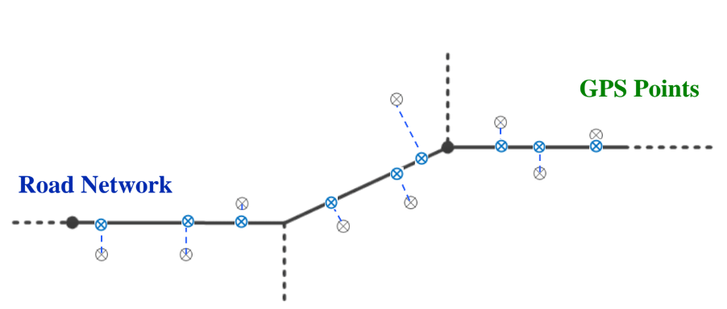
Criteria 1 – GPS error
If the sample point is not in the range of 50 meters of any link nodes, it would be considered as a bad node and discarded.
>50m
Wei, Hong, et al. "Fast Viterbi map matching with tunable weight functions." Proceedings of the 20th International Conference on Advances in Geographic Information Systems. ACM, 2012.

Slide 9
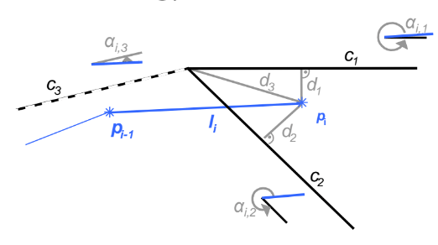
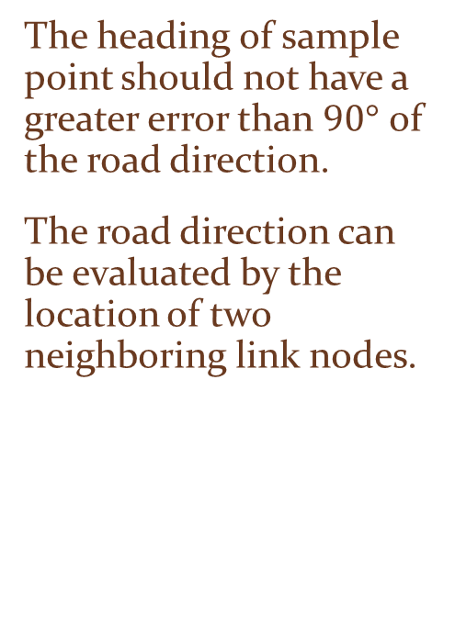
Criteria 2 – Head direction
The heading of sample point should not have a greater error than $90°$ of the road direction.
The road direction can be evaluated by the location of two neighboring link nodes.

Slide 10
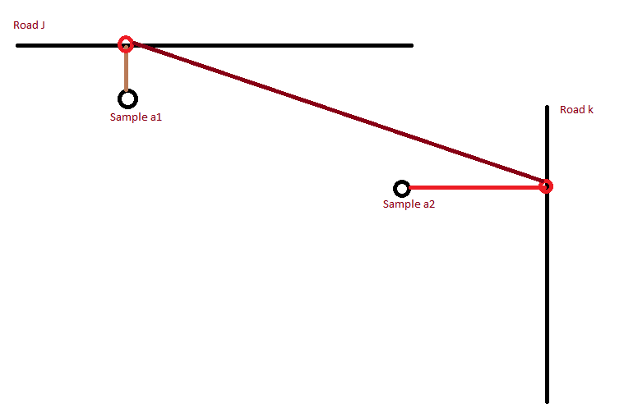


Criteria 3
The road projection distance of each two sample points should not be too large.
Our threshold is:
$$Dist>1.5∗∆t∗SpeedLimit$$
$$Dist≤1.5∗∆t∗SpeedLimit$$

Slide 11
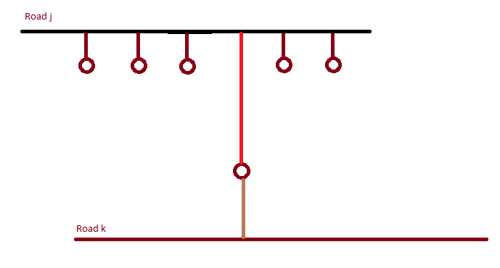
Criteria 4
If only one sample of a sequence of probe samples is matched to a different road link, we re-match it to original road.
Probe 1

Slide 12
Results

Slide 13
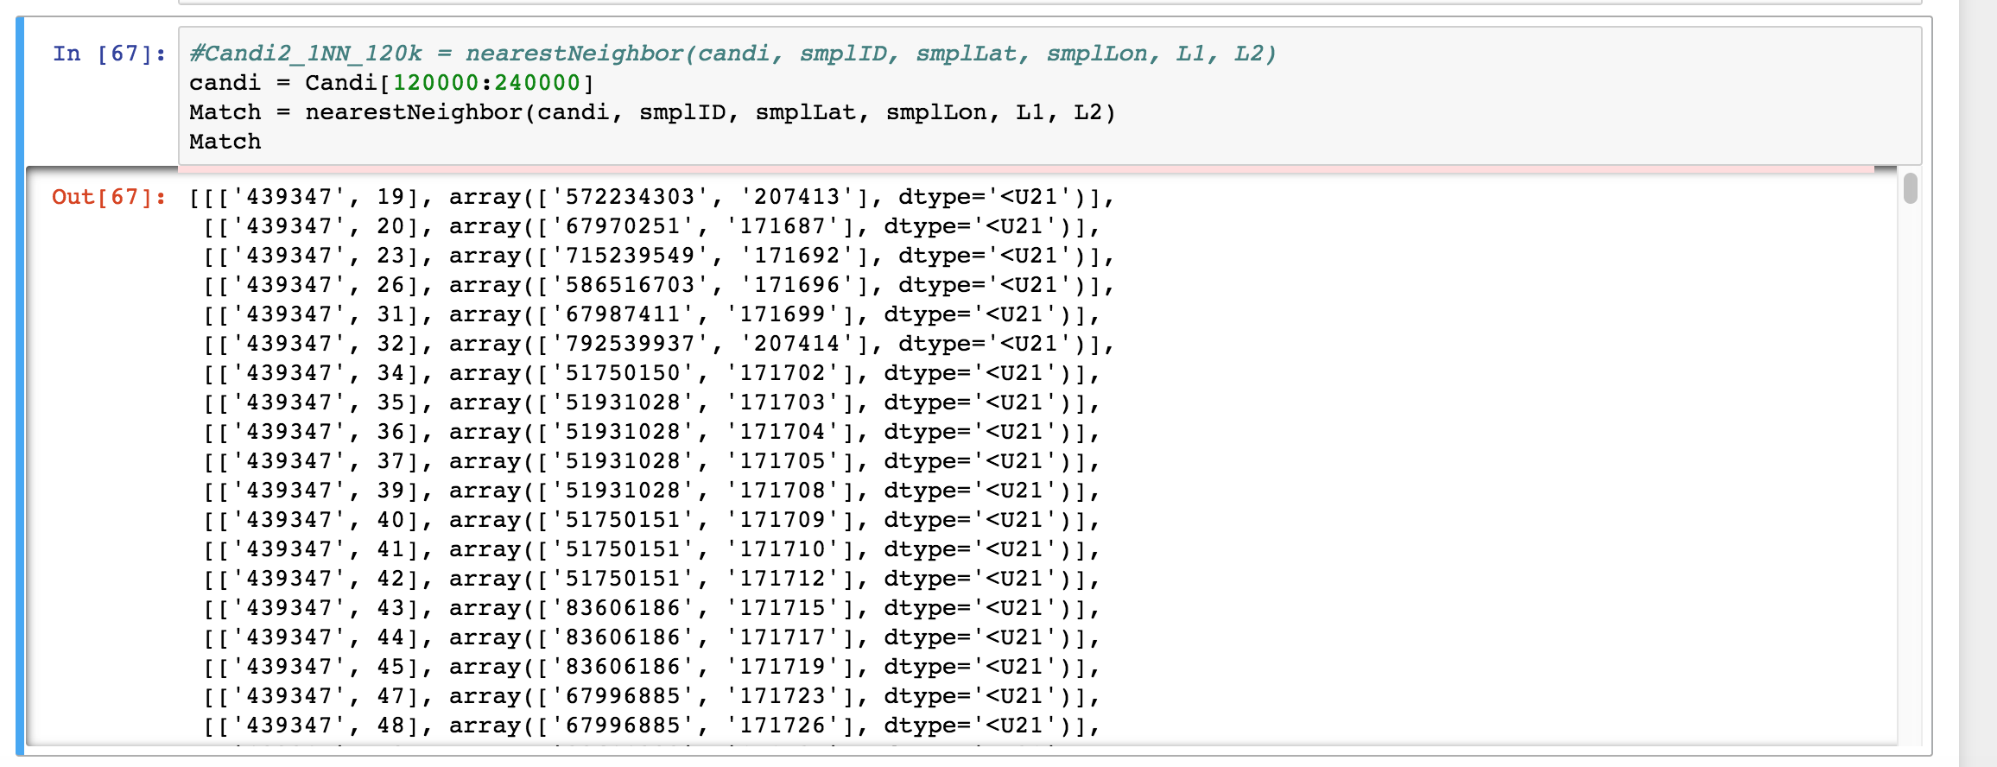
Intermediate Results

Slide 14
Raw Probe Data vs. Matched Road Data
Probe
Road

Slide 15
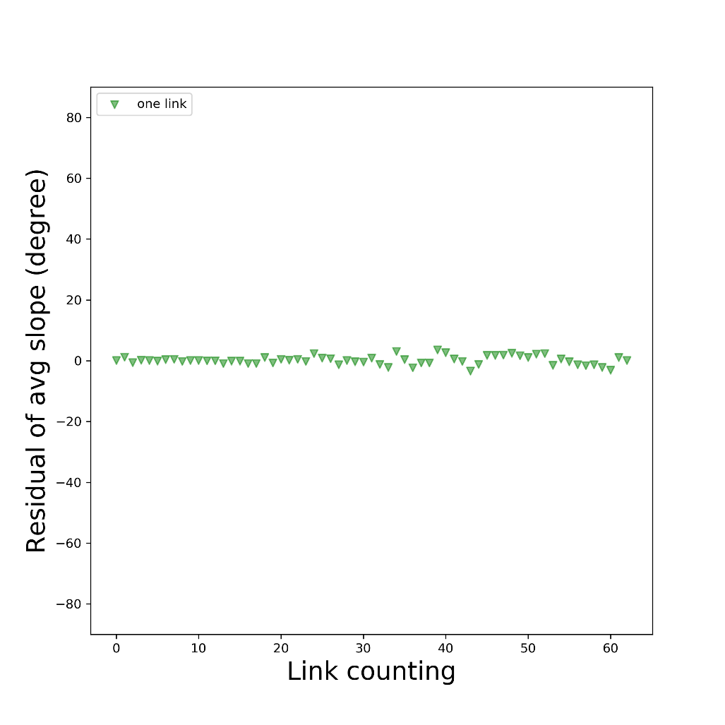
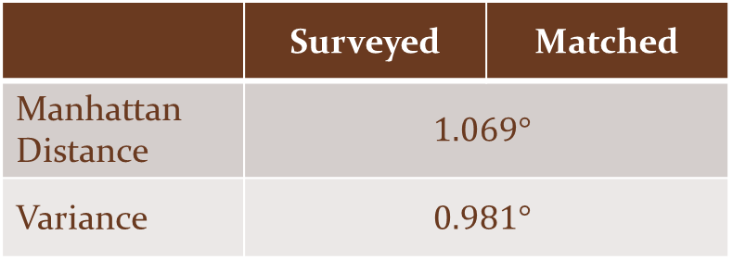
Evaluation of Road Slope
 | Surveyed | Matched
Manhattan Distance | $$1.069°$$
Variance | $$0.981°$$

Slide 16
Thanks！

